Slide 2
Simplified least square equation : Ax = B
A : nt x nc
x : nc (x 1 for individual timeseries)
B : nt (x 1 for individual timeseries)
2D Optimization of UTide (i.e. SWOT, model or any set of timeseries sharing the same time axis) :
Pseudo-2D : compute once and store the A LU decomposition and use it for all the B's individually, over a loop
The inversion of A is done once
Still not vectorized, execution time can suffer from long iteration cycle if the number of timeseries is important
But memory efficient, the matrix B contains only one timeseries each time
2D vectorized : do only one solve call for 2d-array B representing the horizontally stacked B's
Fully vectorized, theoretically the most efficient numerical approach
The matrix B can become very huge, memory issues on personal computers for large dataset (e.g. HR model)

Slide 3
2D Implementation of UTide (i.e. SWOT, model or any set of timeseries sharing the same time axis) :

Slide 4
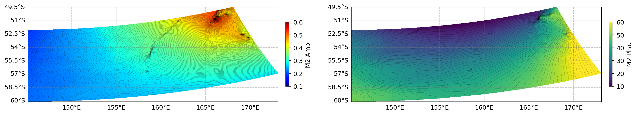
Use cases : Tidal Analysis
SHOC model elevation outputs
Application on SHOC hourly elevations, for a 3-month run (59070 grid points, 2184 timesteps)
8 constituents, no confidence interval
2D/Vectorized : 11 seconds
1D/Recursive : 2200 seconds (35 min)
8 constituents, with confidence interval
2D/Vectorized : 110 seconds
1D/Recursive : 2435 seconds (41 min)
CI calculation, based on residual PSD at tidal frequencies, is still 1D recursive in the 2D solver
Amplitude and phase of M2, computed on SHOC model in the ACC-SMST area

Slide 5
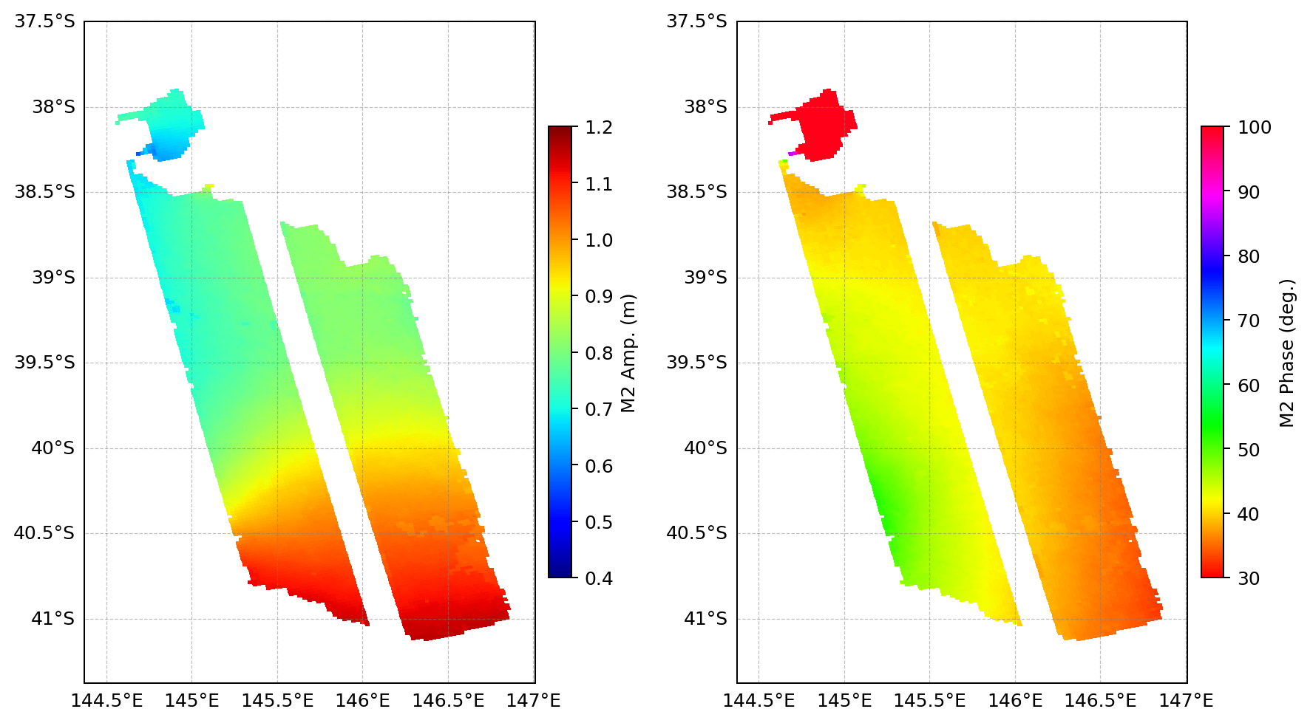
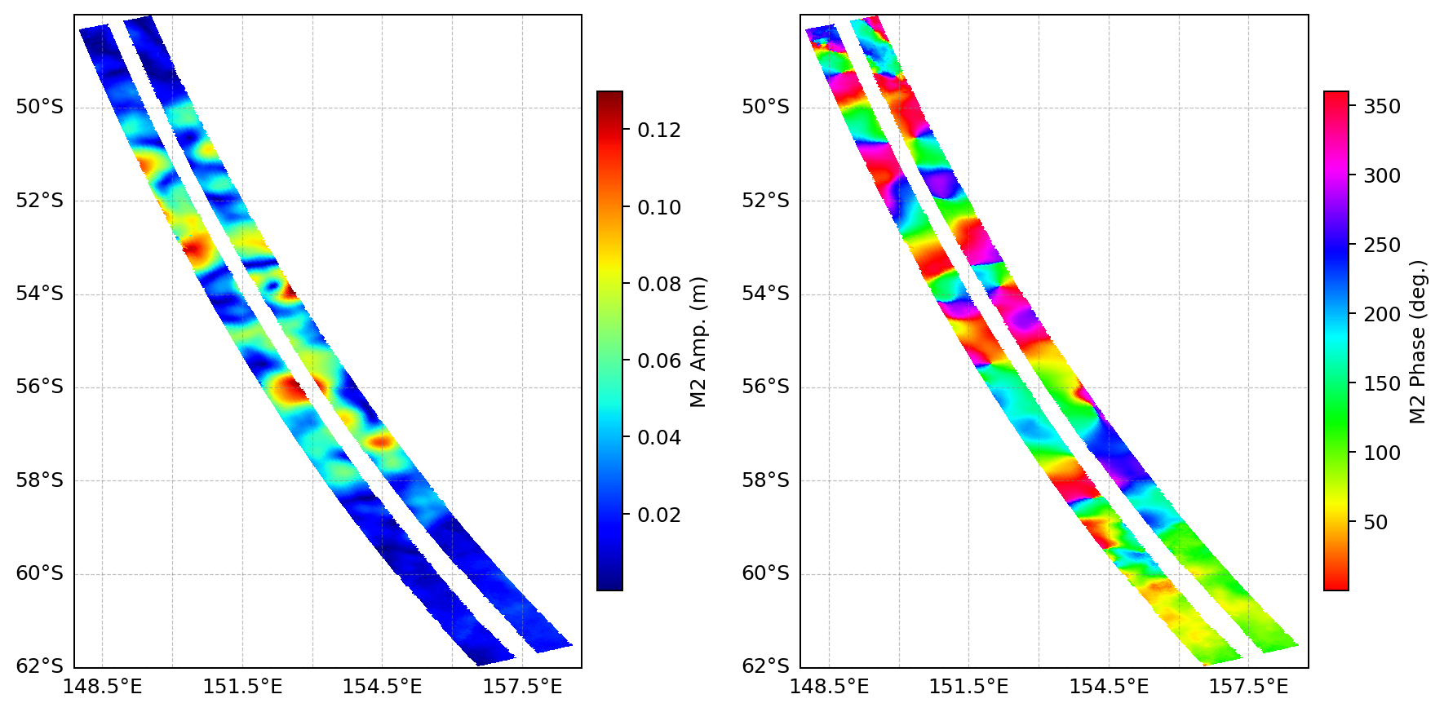
Use cases : Tidal Analysis
SWOT FSP track #006
Barotropic tide
SWOT FSP SSH (SSHA uncorrected from tides), in Bass Strait
(14145 grid points, 80 pass)
8 constituents, no confidence interval
2D/Vectorized : 0.14 seconds
1D/Recursive : 130 seconds
Internal tide
SWOT FSP SSHA (Corrected from FES2022 tides), in ACC-SMST
(55545 grid points, 80 pass)
8 constituents, no confidence interval
2D/Vectorized : 0.53 seconds
1D/Recursive : 440 seconds
Non-locked signal/eddies contamination
Phase locked M2 internal tide

Slide 7
Roadmap
Confidence intervals
2D reconstruction
Inference
Nodal factors
Test/Benchmarking

